Slide 1
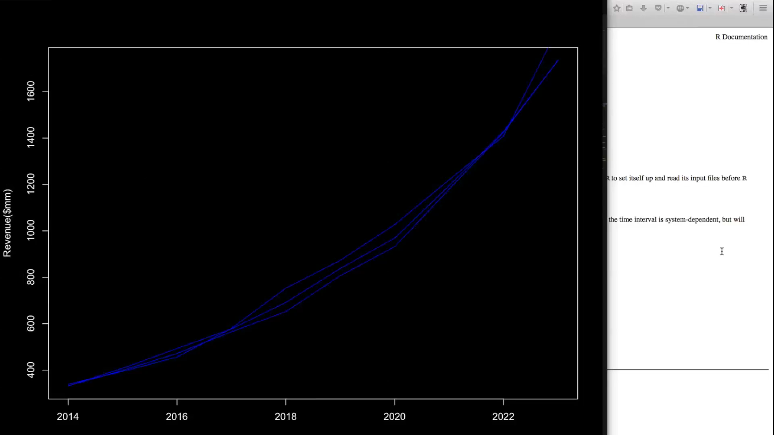
Whatever you want to be at the top
1600
1400
1200
Revenue($mm)
1000
800
600
400
2014
2016
2018
2020
2022

